Slide 1
Data Visualization and bea.R
Jeff Chen and Andrea Batch

Slide 2
Overview
Designing Visualizations
Visualization Practices in Journalism
Tools: A demo using bea.R and Leaflet R libraries

Slide 3

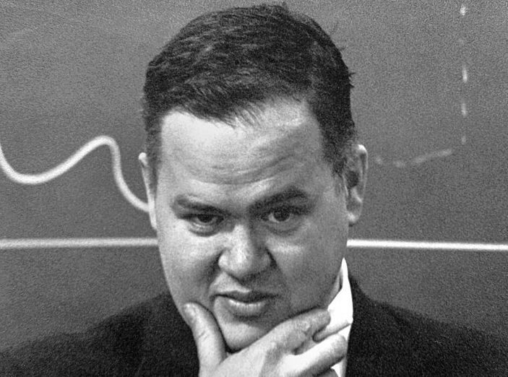
Visualization: Why?
“The purpose of computing is insight, not numbers.” -Richard Hamming
“Far better an approximate answer to the right question, which is often vague, than an exact answer to the wrong question, which can always be made precise.” -John Tukey

Slide 4
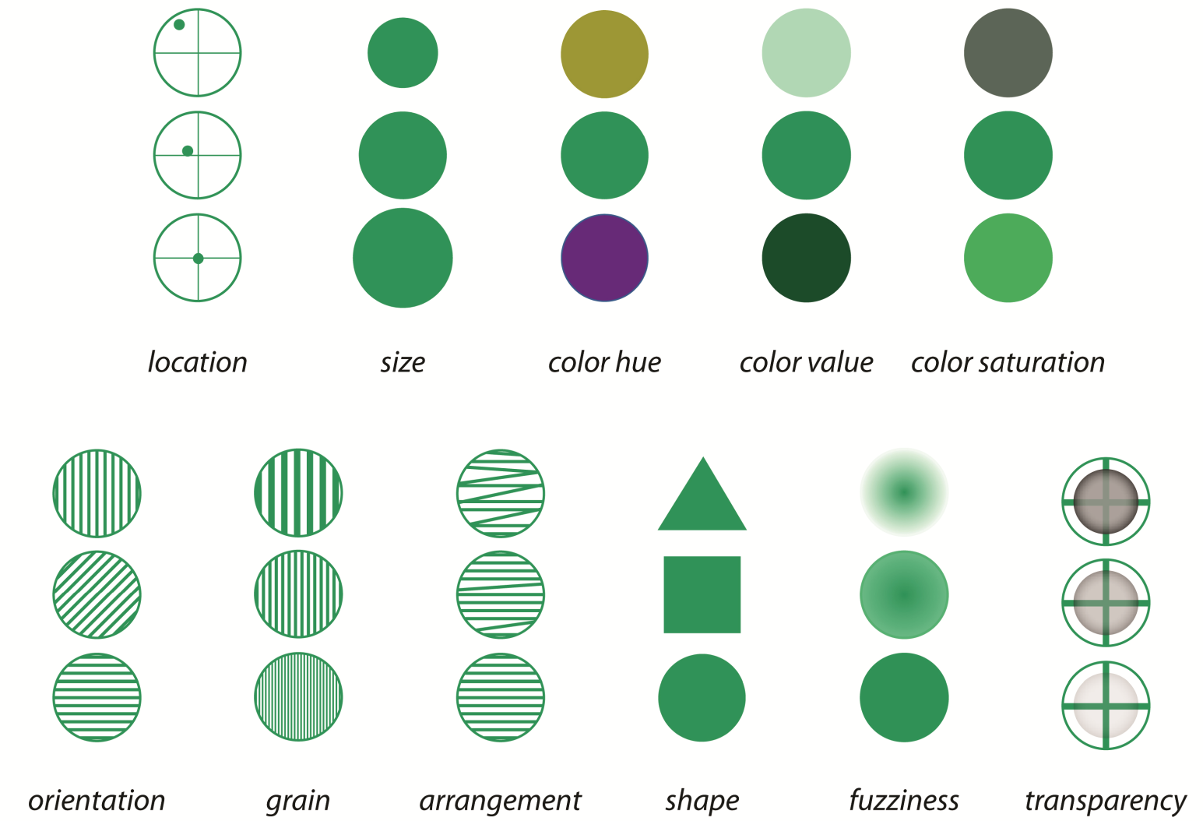
The Visual Variables
Concept originated by Bertin, J. "Sémiologie Graphique.” 1974
A. M. MacEachren et al. "Visual Semiotics & Uncertainty Visualization: An Empirical Study," IEEE Transactions on Visualization and Computer Graphics, 18(12), pp. 2496-2505, Dec. 2012.

Slide 5
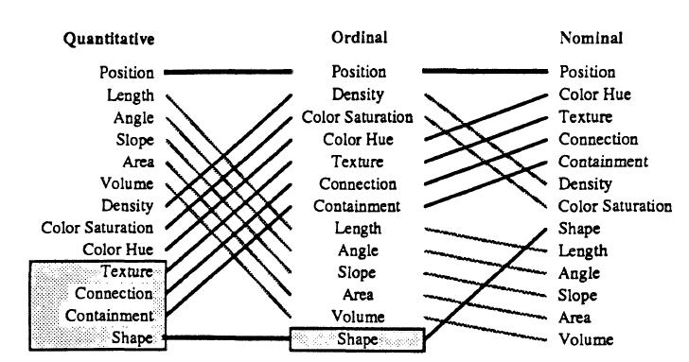
Location (AKA “Position”) Always Wins…
J. Mackinlay, Automating the Design of Graphical Presentations of Relational Information. 1986

Slide 6
…Unless There Is Animation
Strong visual cue; eye is sensitive to motion in peripheral vision
Gestalt Law of Common Fate —elements with the same moving direction are perceived as a unit
Tracking limit of the human eye is around 4-6 objects

Slide 7

Interactions: Information-Seeking Mantra
“Overview first, zoom and filter, then details on demand”
-Ben Shneiderman, The Eyes Have It. 1996

Slide 8
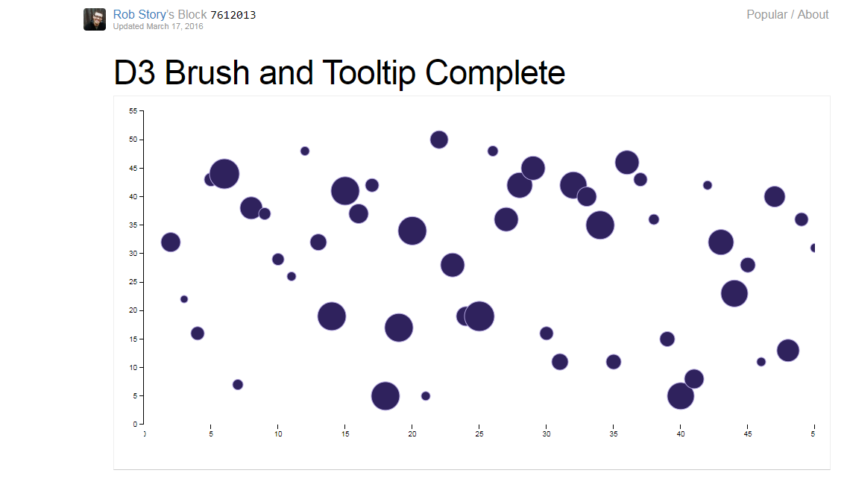
“Overview first…”

Slide 9
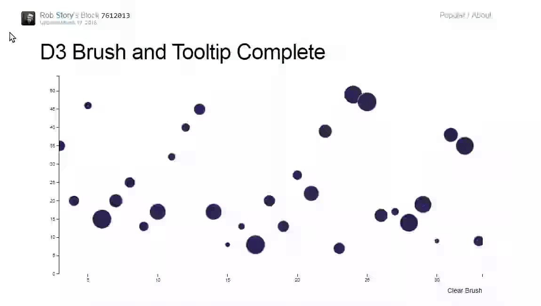
“… zoom & filter…” [Navigate, Highlight, Select]

Slide 10
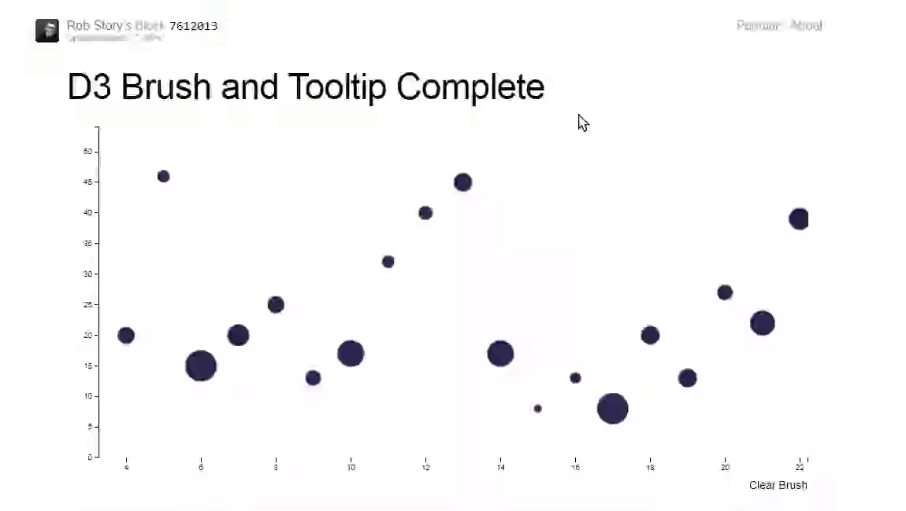
“…then Details on Demand”

Slide 11
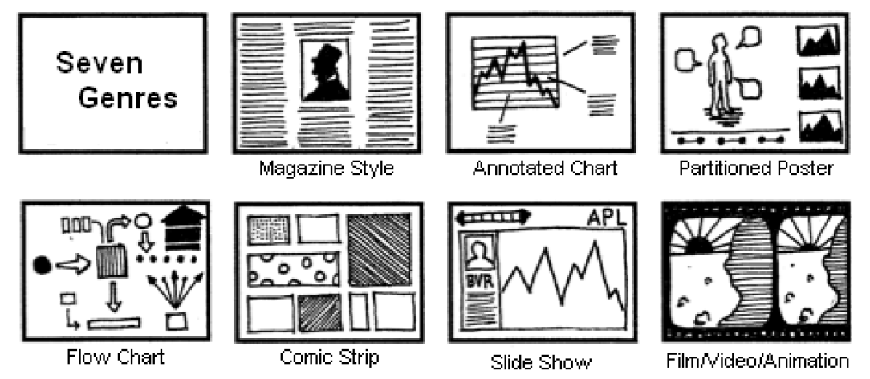
Data Storytelling: How Do Journalists Visualize?
E. Segel and J. Heer, "Narrative Visualization: Telling Stories with Data." IEEE Transactions on Visualization and Computer Graphics, 16 (6), pp. 1139-1148, 2010.

Slide 12
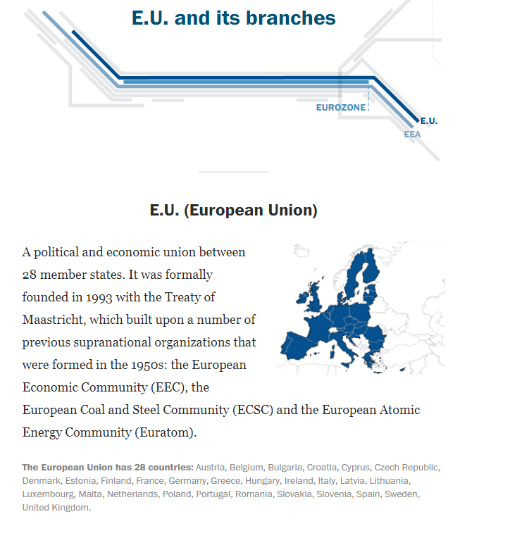
Visual Narratives: Magazine Style
W. Cai et al. “Europe’s many alliances, reimagined as a Metro system,” The Washington Post, 2016.

Slide 13
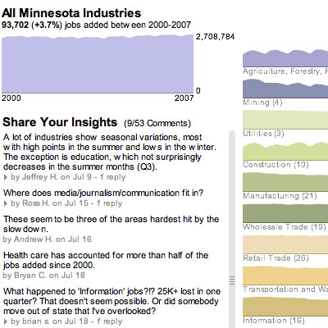
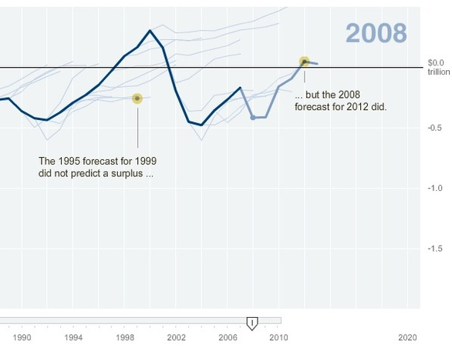
Visual Narratives: Annotated Charts
Author-Driven Reader-Driven
New York Times. Budget Forecasts, Compared With Reality.
Minnesota Public Radio. Minnesota Employment Explorer.
via E. Segel and J. Heer, 2010

Slide 14
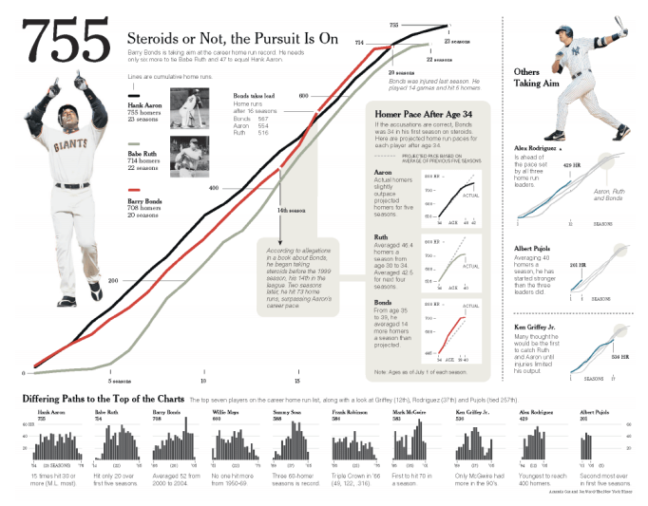
Visual Narratives: Partitioned Poster
New York Times via E. Segel and J. Heer, 2010.

Slide 15
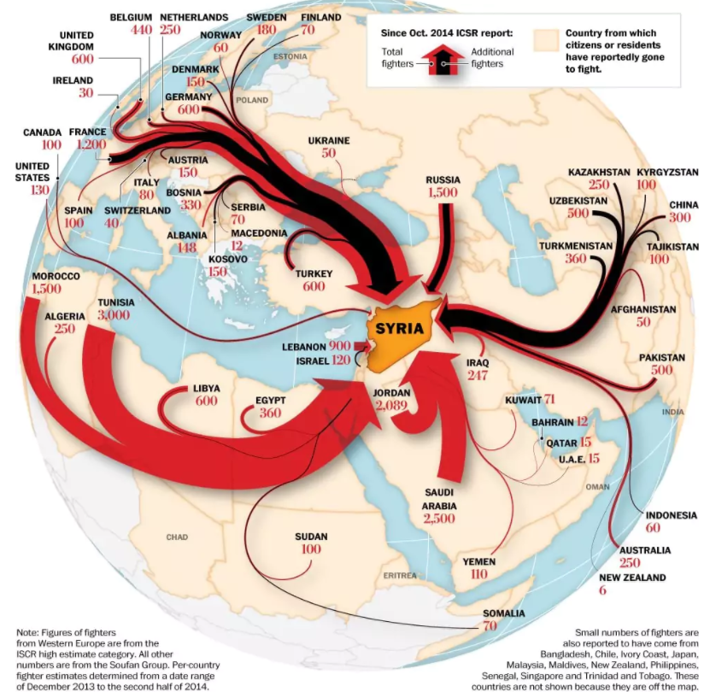
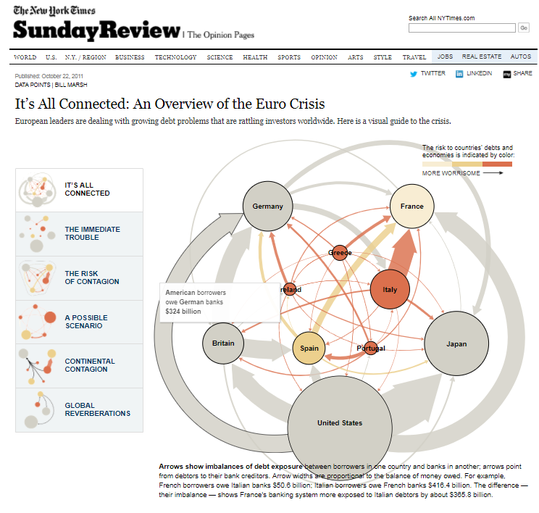
Visual Narratives: Flow Chart
B. Marsh. “It’s All Connected: An Overview of the Euro Crisis.” The New York Times, Oct. 2011.
G. Thorp and S. Sharma, “Foreign fighters flow to Syria.” The Washington Post, Jan. 2015.

Slide 16
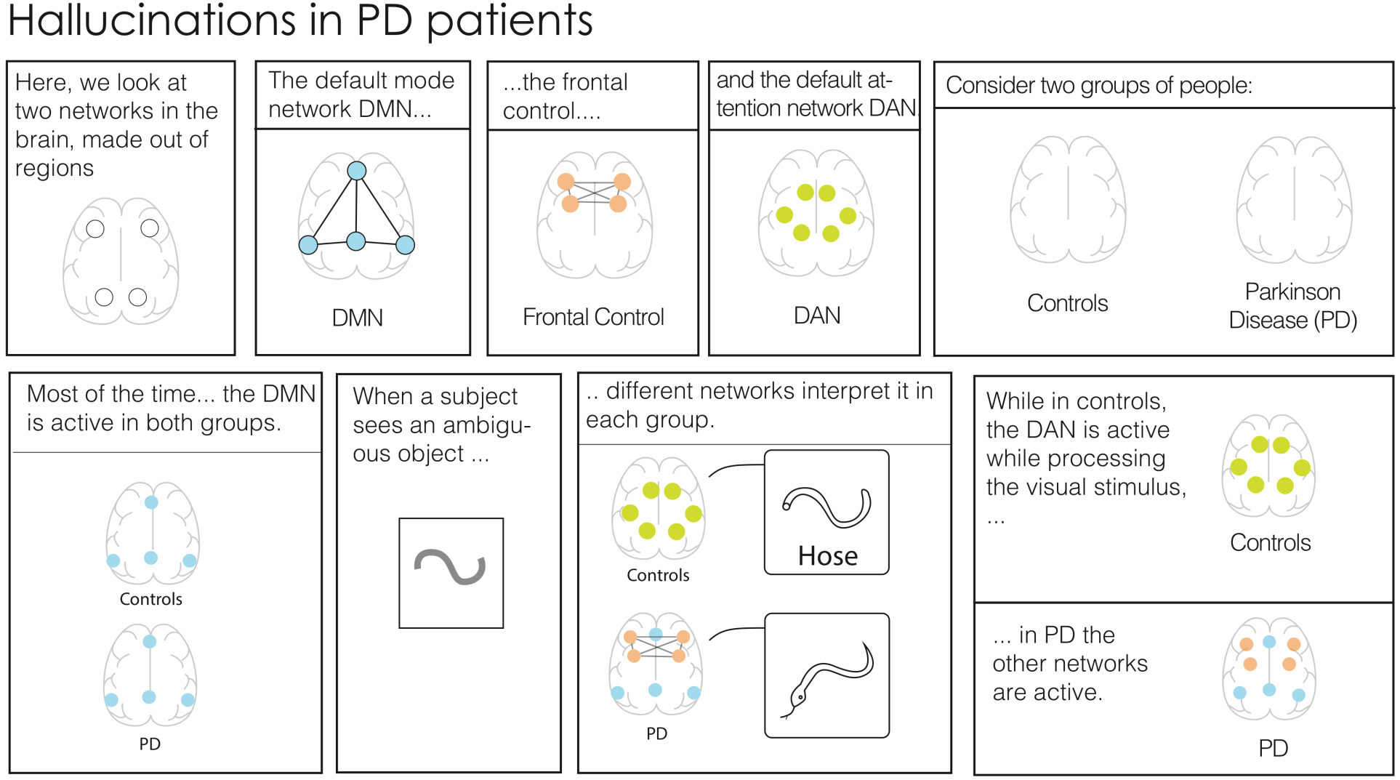
Visual Narratives: Data comics
Graph Comics: http://www.aviz.fr/~bbach/graphcomics/
B. Bach et al. “Telling Stories about Dynamic Networks with Graph Comics.” In Proceedings of the CHI Conference on Human Factors in Computing Systems, 2016.

Slide 17

Visual Narratives: Slide Show
K. Park, “How dry is California?” The Washington Post, Oct. 2015.

